Slide 1
Linear Regression
主讲人：傅启明
苏州科技大学

Slide 2
Linear Regression
House Pricing
Price
(in 1000s of dollars)
Size (feet²)

Slide 3
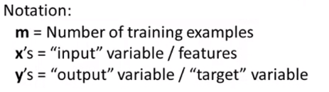
Linear Regression
training set
Area in feet² (x) | Size ($) in 1000's (y)
2104 | 460
1416 | 232
1534 | 315
852 | 178
… | …

Slide 4
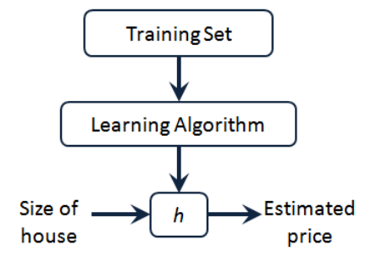
Process

Slide 5
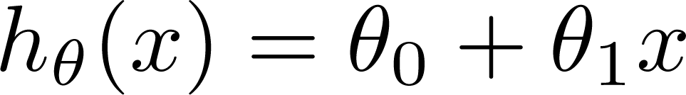

Cost Function
Training set
Size in feet² (x) | Price ($) in 1000's (y)
2104 | 460
1416 | 232
1534 | 315
852 | 178
… | …
Hypothesis:
: Parameters
How to Choose:

Slide 6
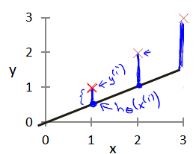


Slide 7
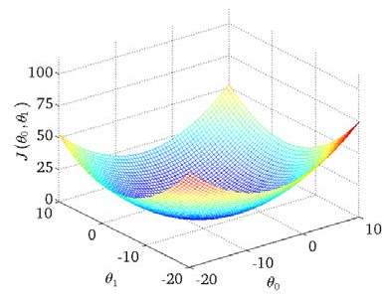

Cost Function
$$J\left(θ_{0},θ_{1}\right)=\frac{1}{2m}\sum_{i=1}^{m}{{\left(h_{θ}(x^{\left(i\right)})−y^{\left(i\right)}\right)}^{2}}$$

Slide 8
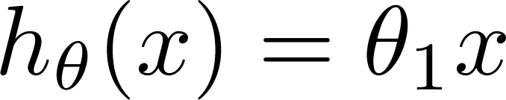
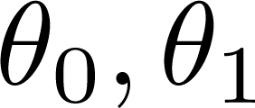

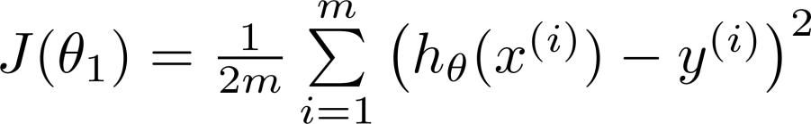
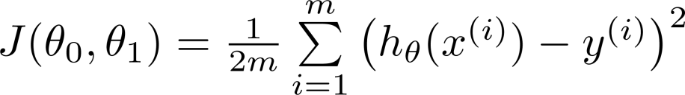
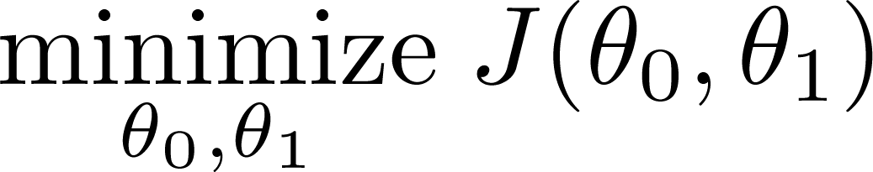
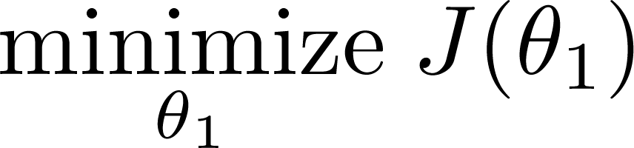
Cost function intuition
Hypothesi:
simplitication
Parameters:
Cost function:
Goal:

Slide 9

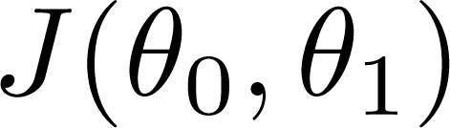




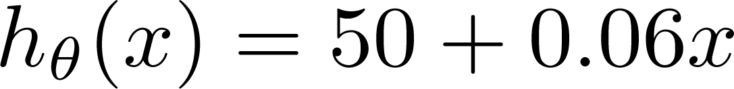
(for fixed , this is a function of x)
(function of the parameters )
Price ($)
in 1000’s
Size in feet² (x)

Slide 10
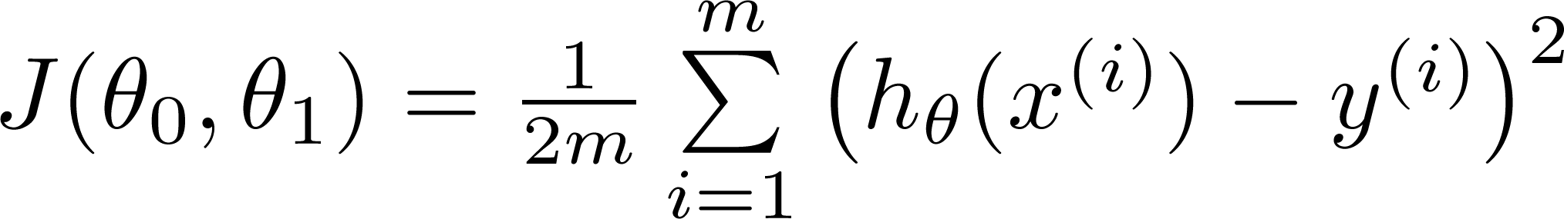
Hypothesis:
Parameters:
Cost Function:
Goal:

Slide 11
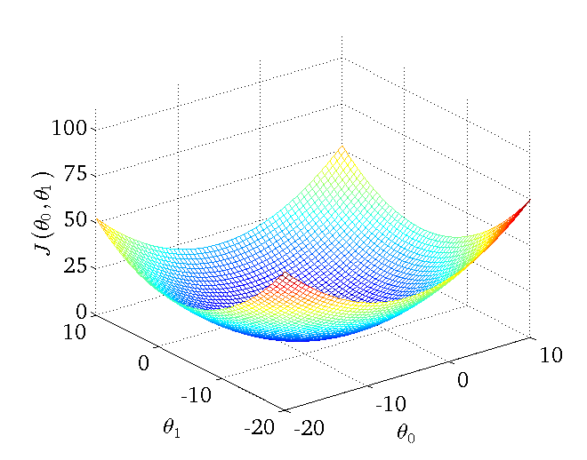

Slide 12
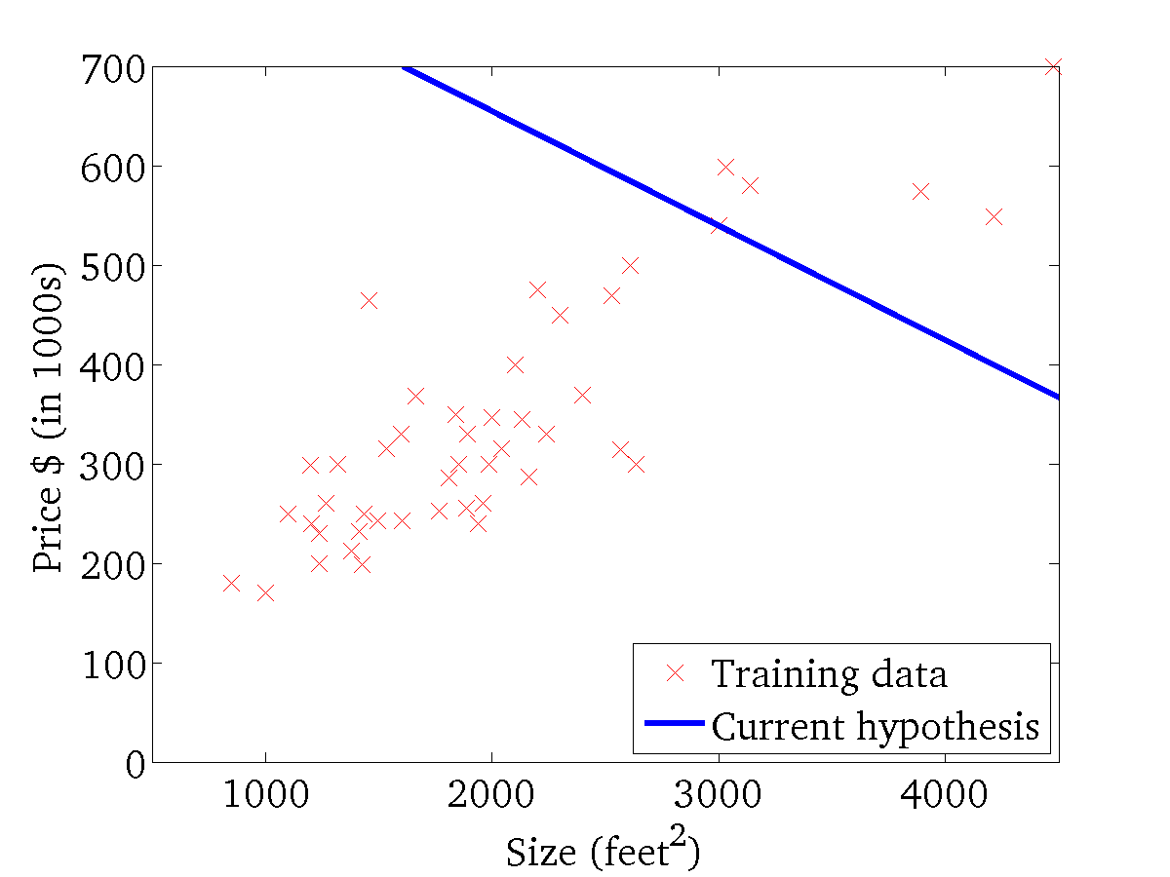
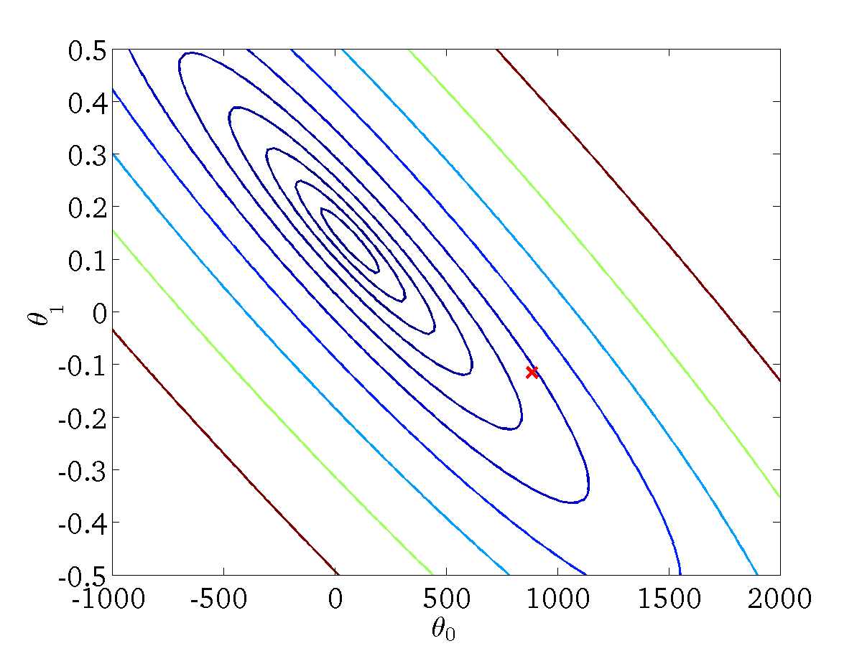
(for fixed , this is a function of x)
(function of the parameters )

Slide 13
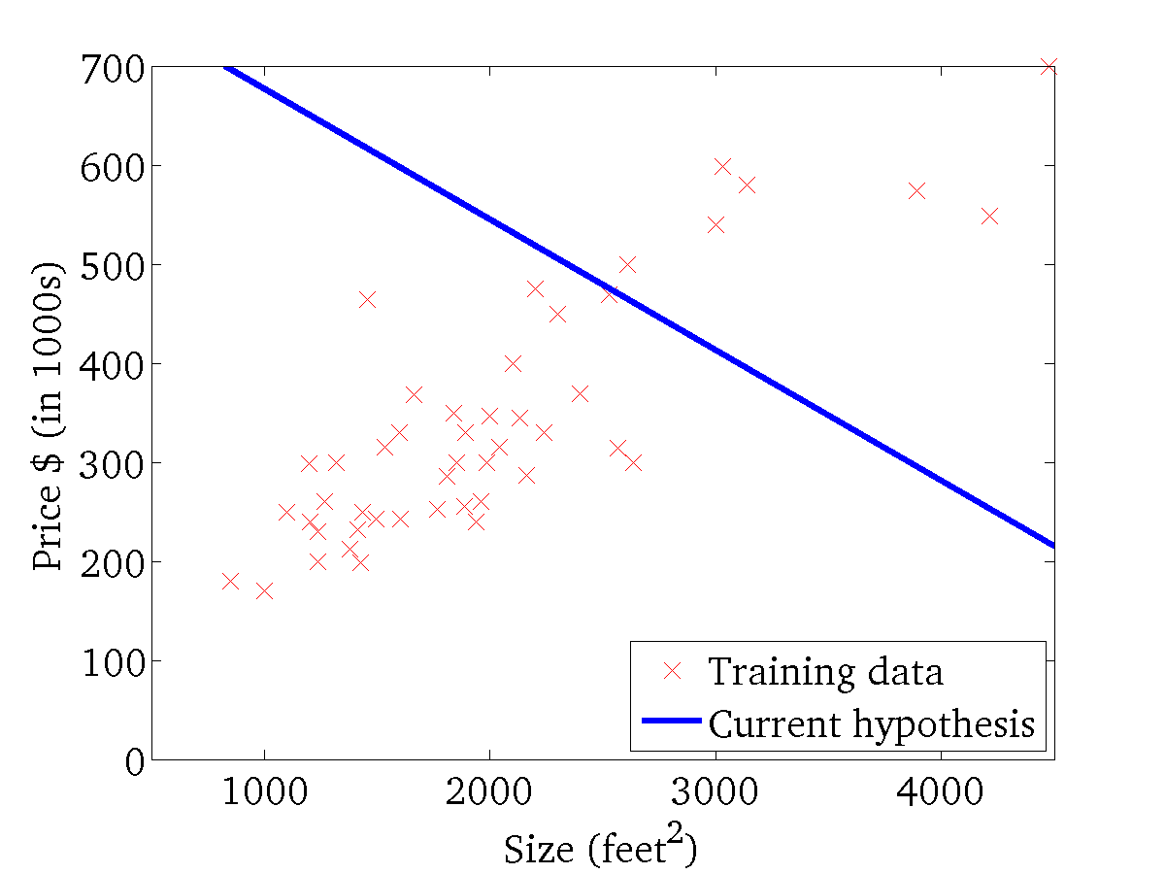

(for fixed , this is a function of x)
(function of the parameters )

Slide 14
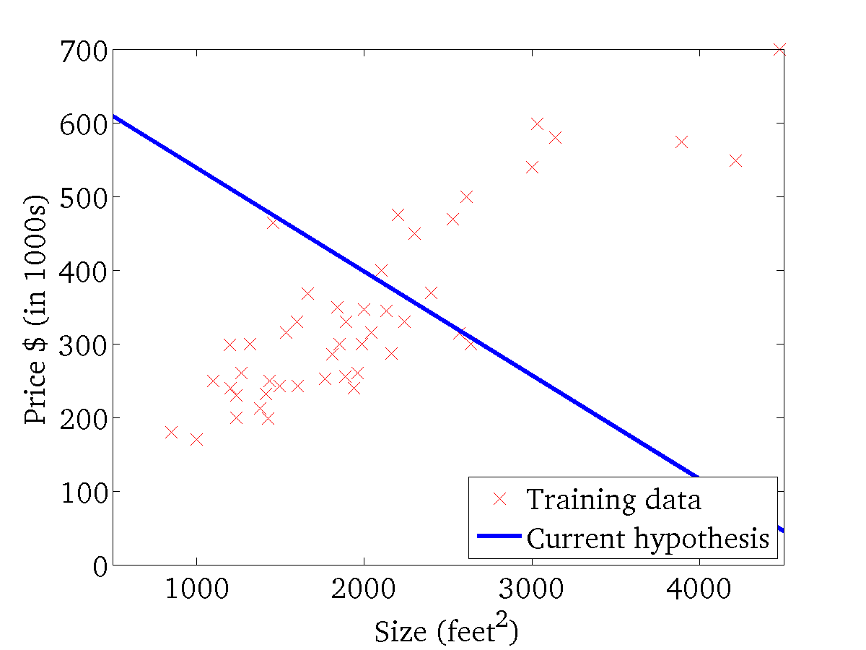
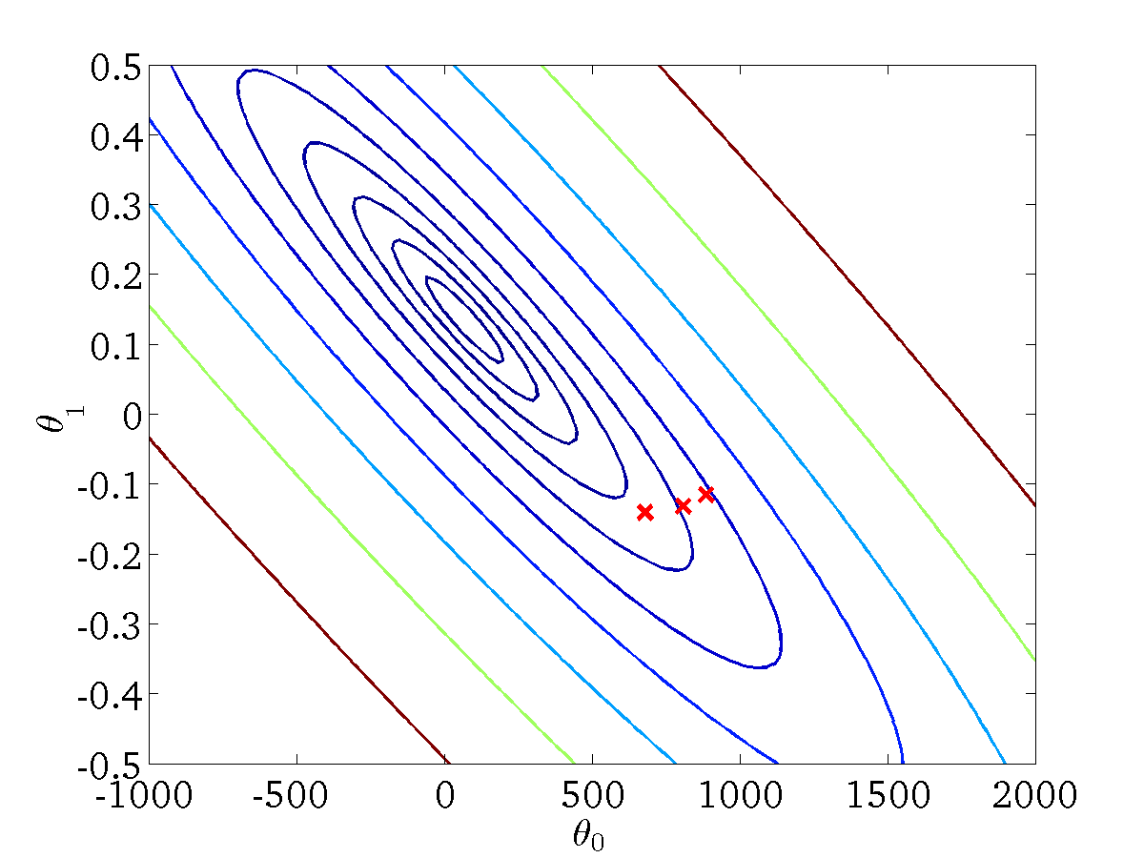
(for fixed , this is a function of x)
(function of the parameters )

Slide 15
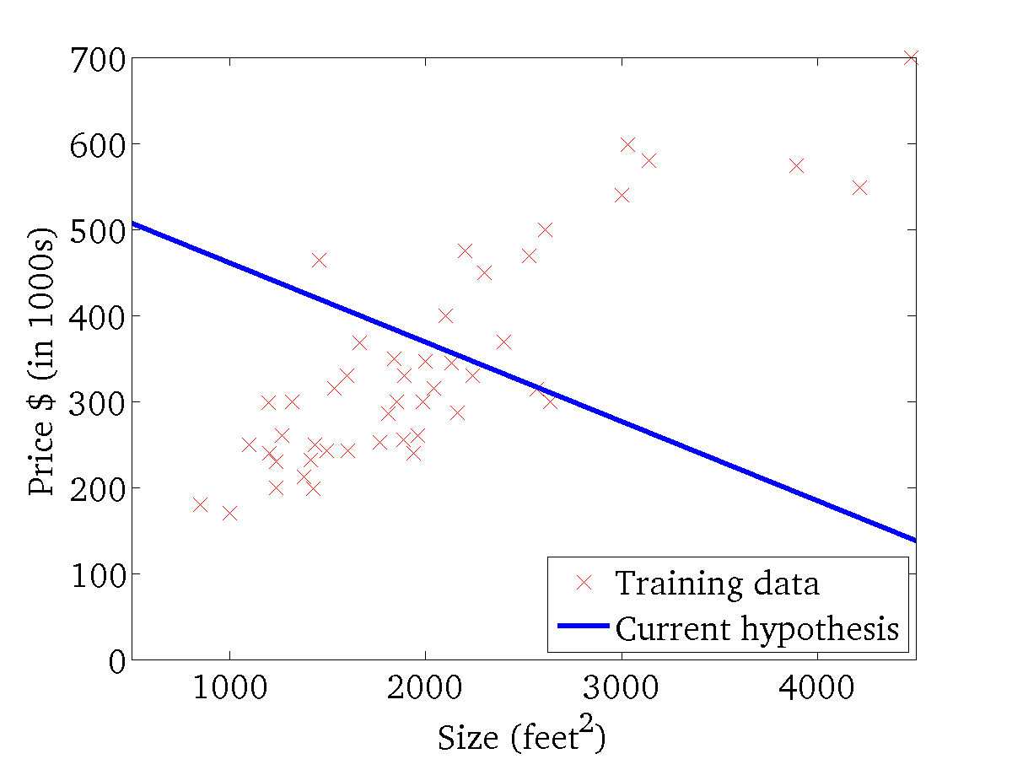

(for fixed , this is a function of x)
(function of the parameters )

Slide 16
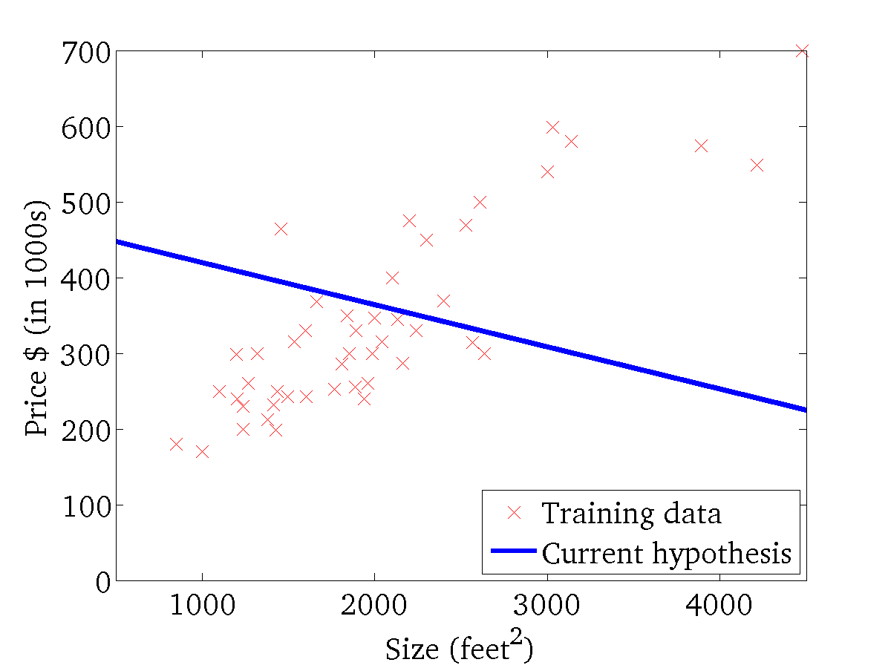
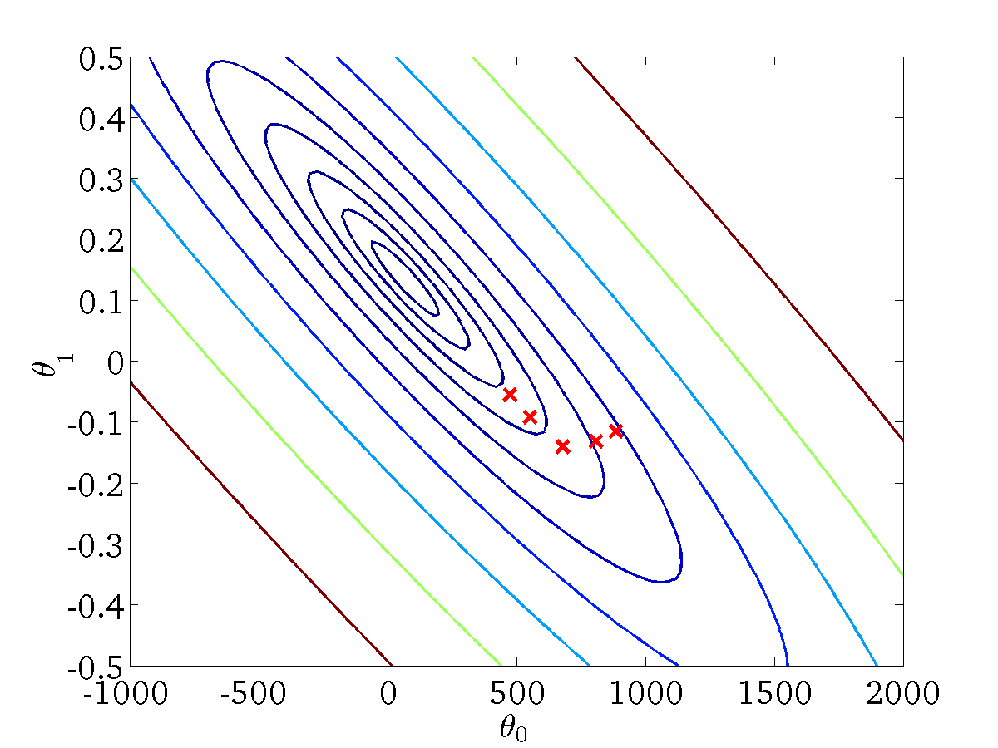
(for fixed , this is a function of x)
(function of the parameters )

Slide 17
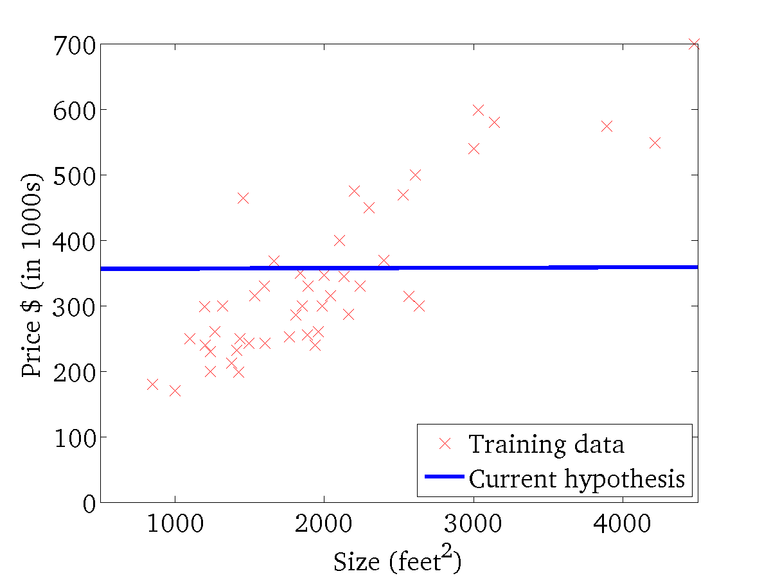

(for fixed , this is a function of x)
(function of the parameters )

Slide 18
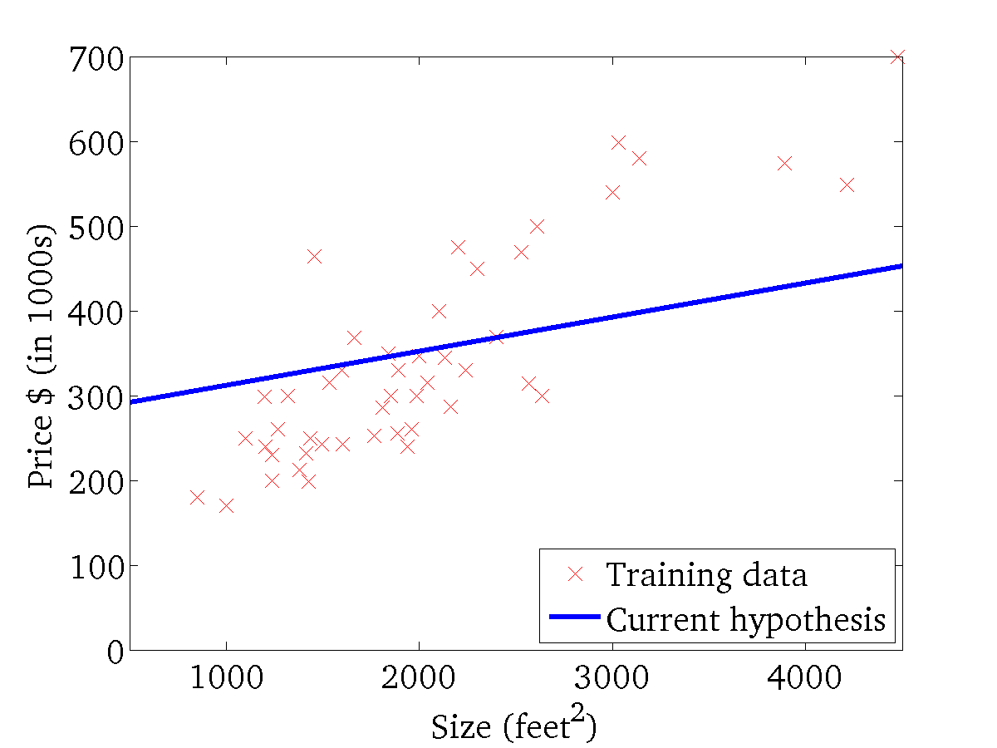

(for fixed , this is a function of x)
(function of the parameters )

Slide 19
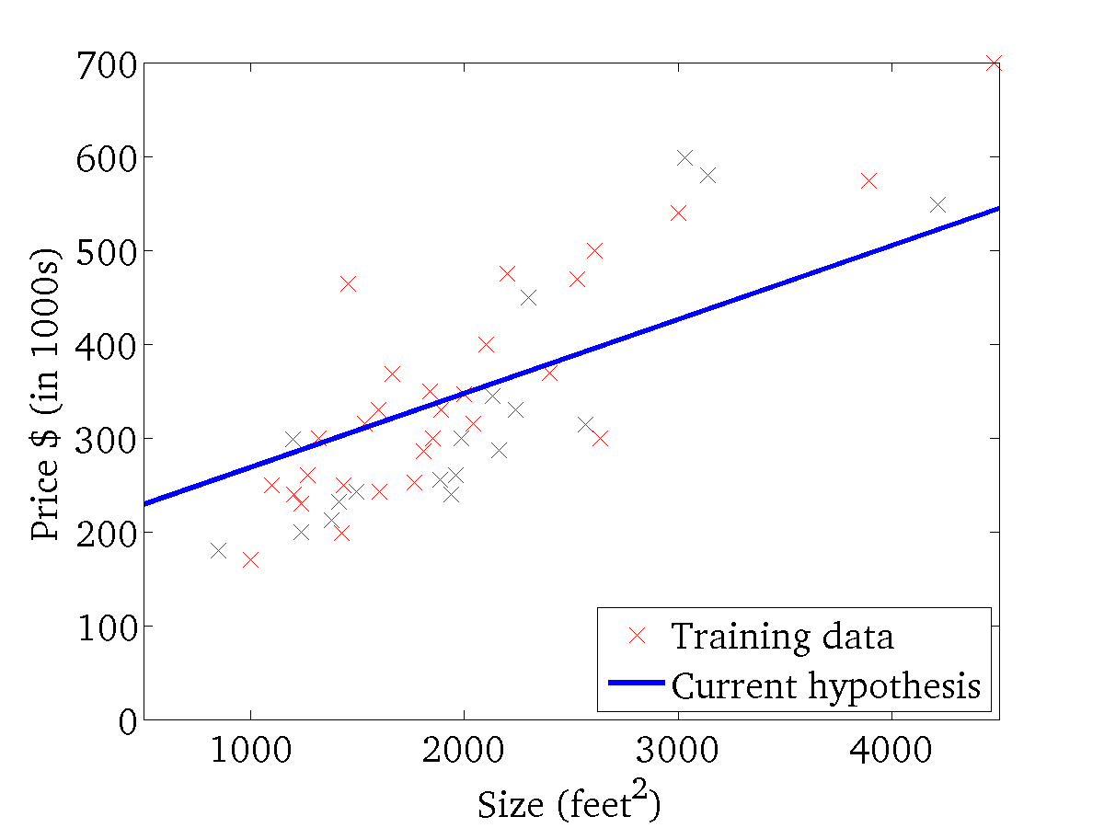
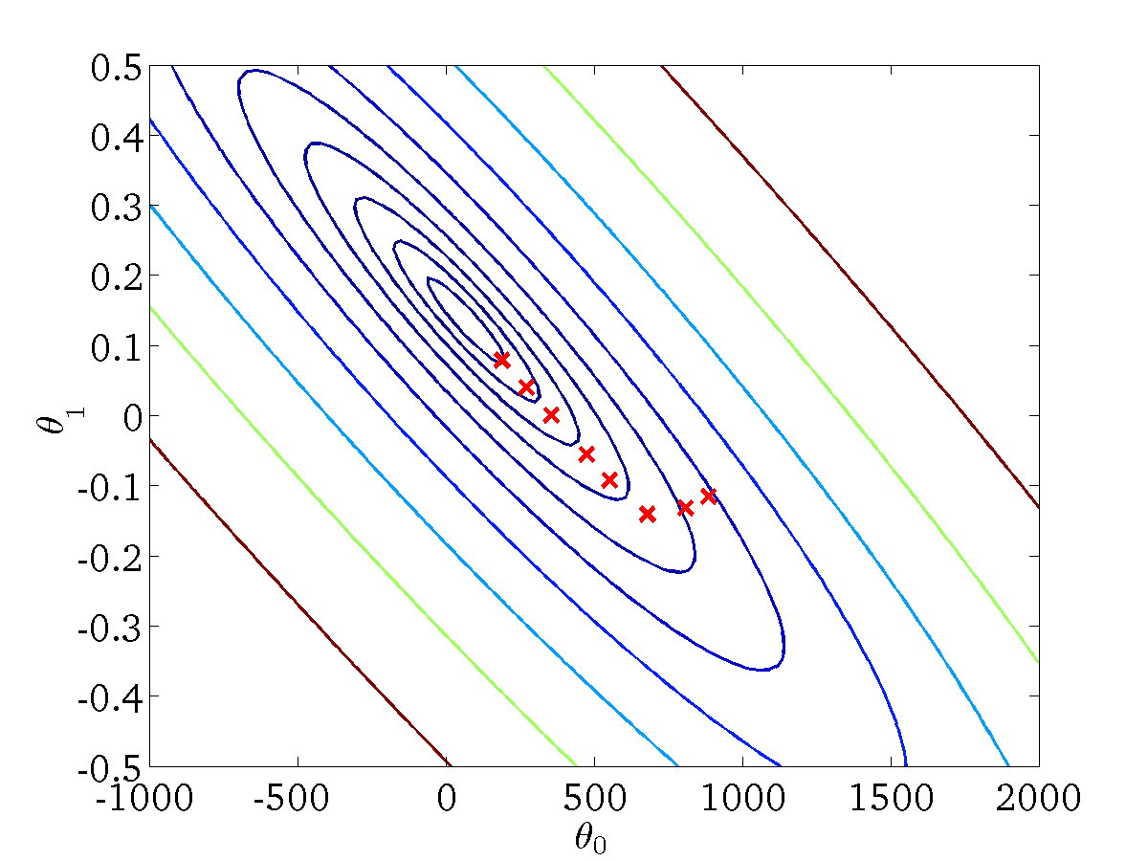
(for fixed , this is a function of x)
(function of the parameters )

Slide 20
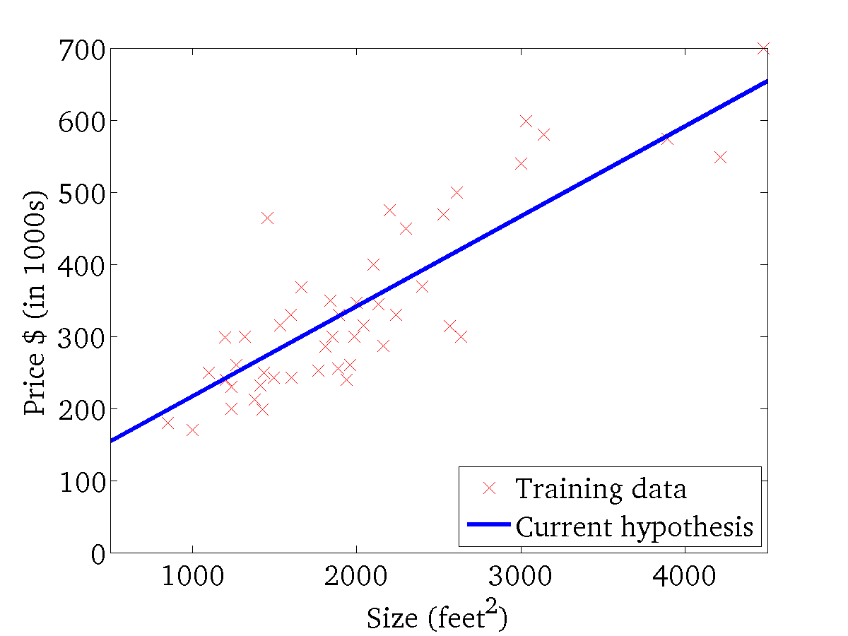

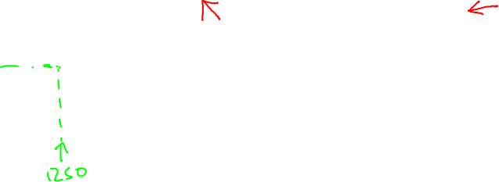
(for fixed , this is a function of x)
(function of the parameters )

Slide 21
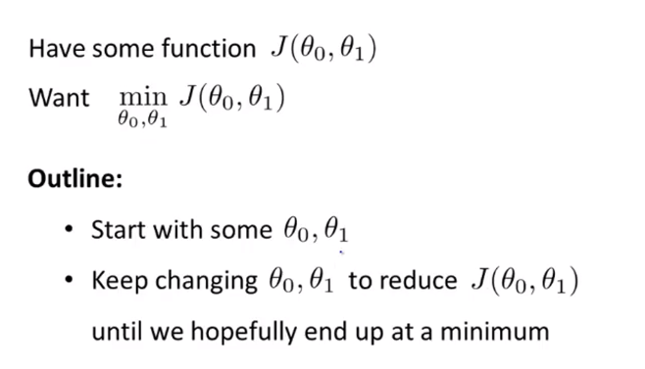
Gradient Descent Method

Slide 22
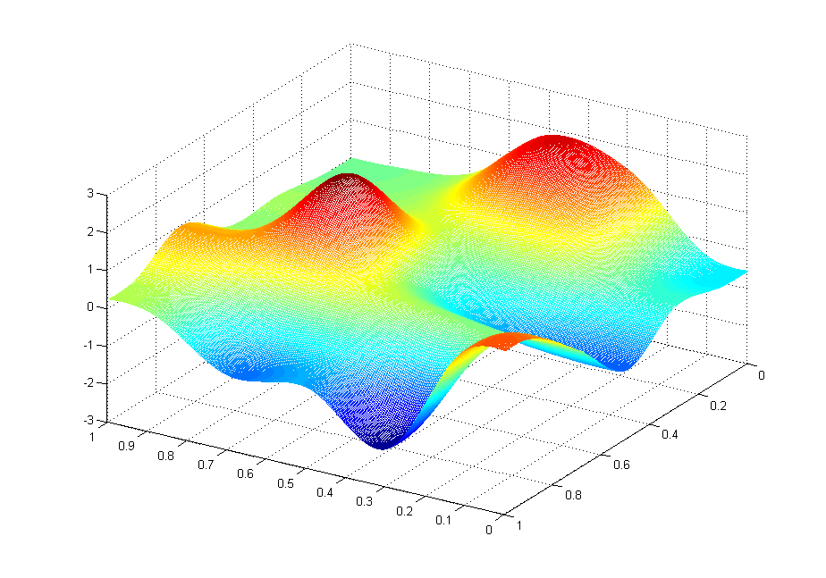
J(θ₀,θ₁)
θ₁
θ₀

Slide 23
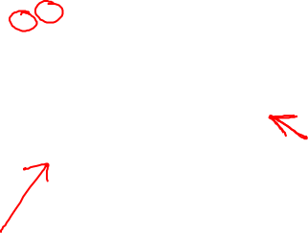
J(θ₀,θ₁)
θ₁
θ₀

Slide 24
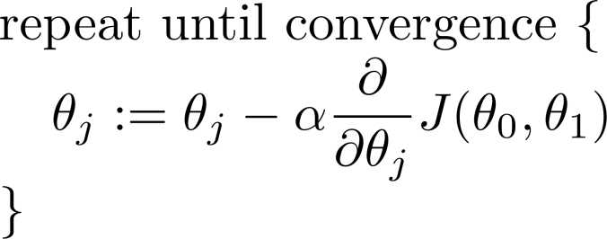
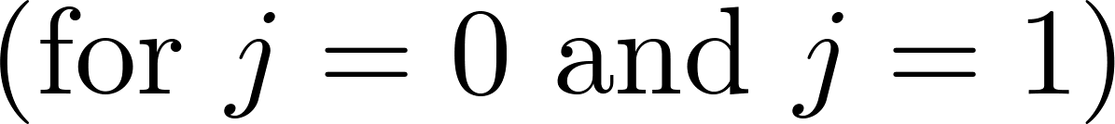
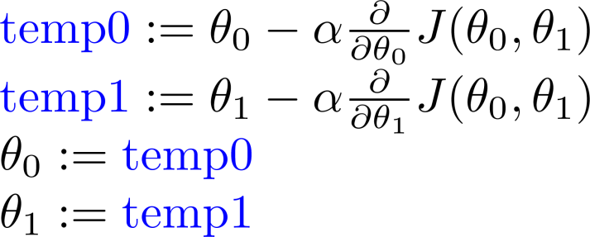
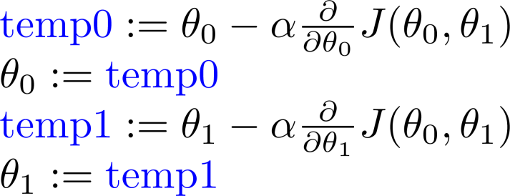
Correct: Simultaneous update
wrong: one by one

Slide 25
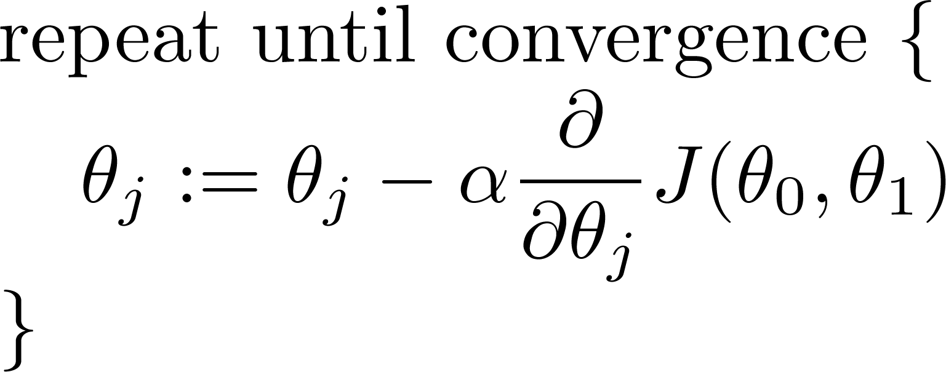
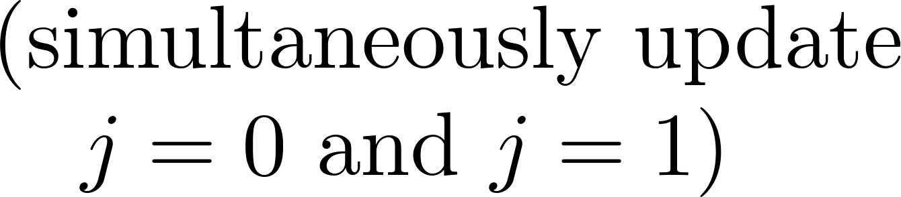
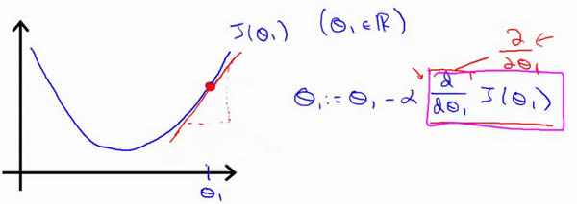
Gradient Descent initution

Slide 26
Gradient Descent initution

Slide 27

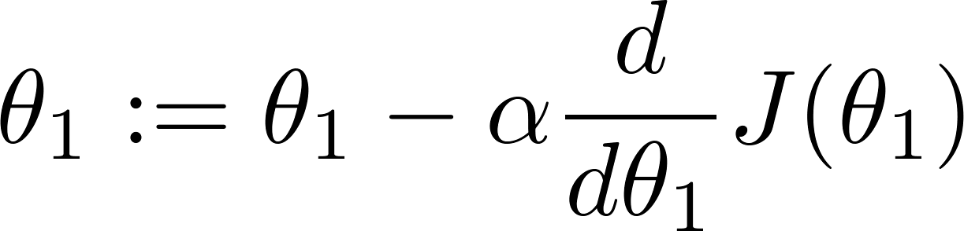
Gradient Descent initution
at local optima
Current value of

Slide 28
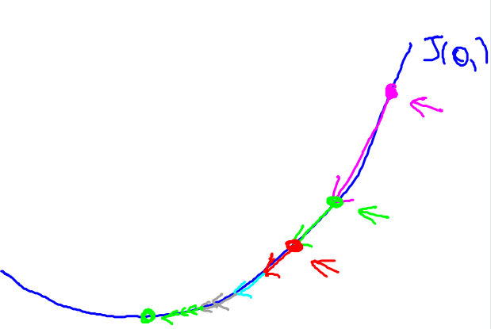
Gradient descent can converge to a local minimum, even with the learning rate α fixed.
As we approach a local minimum, gradient descent will automatically take smaller steps. So, no need to decrease α over time.

Slide 29
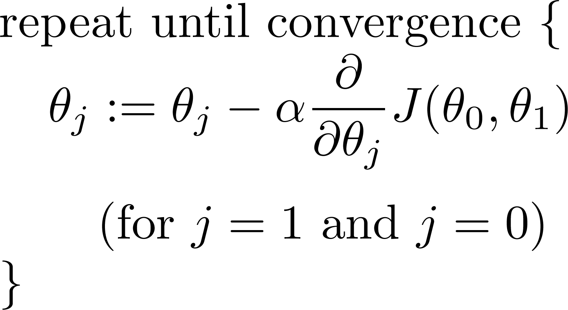
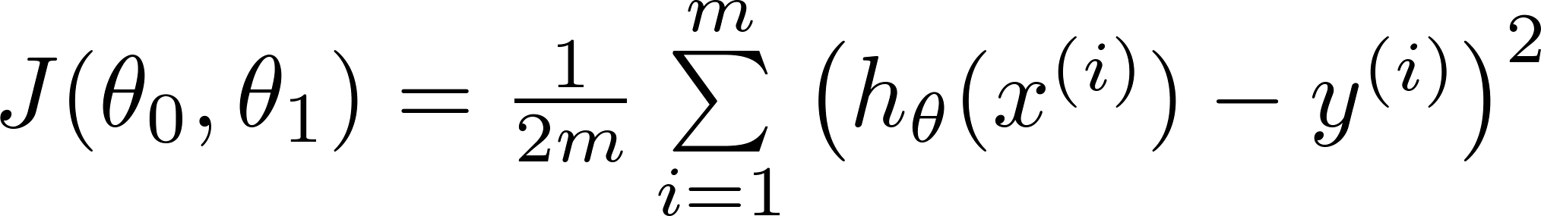
Linear Regression
Gradient Descent method
Linear Regression model

Slide 30
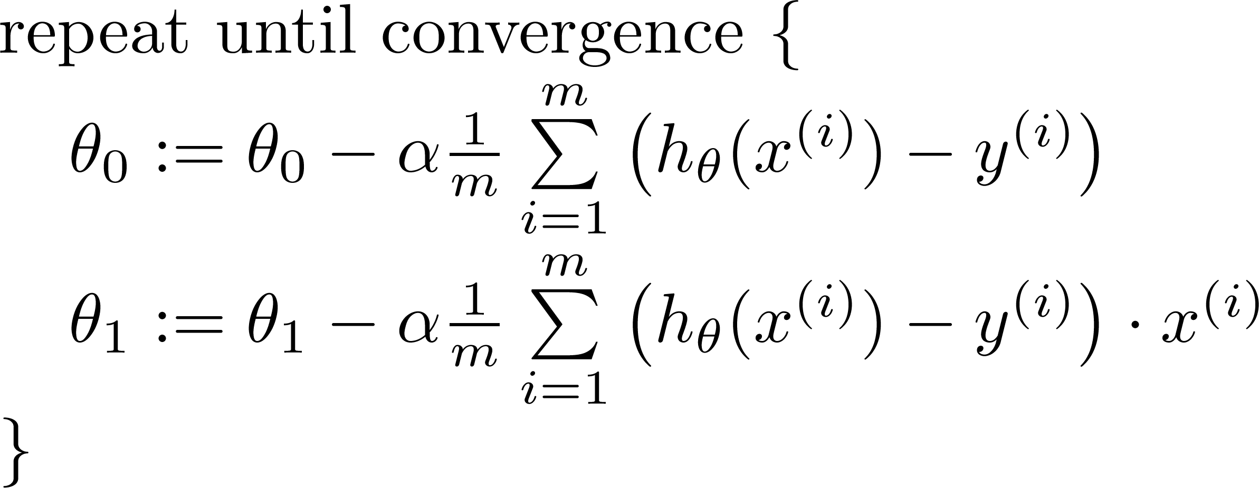

and

Slide 31
J(θ₀,θ₁)
θ₁
θ₀

Slide 32
J(θ₀,θ₁)
θ₁
θ₀

Slide 33
Linear Regression
Linear Regression
with multiple variables

Slide 34



Single Feature (variable)
Size (feet²) | Price ($1000)
2104 | 460
1416 | 232
1534 | 315
852 | 178
… | …

Slide 35



Multiple features (variables)
Size (feet²) | Number of bedrooms | Number of floors | Age of home (years) | Price ($1000)
2104 | 5 | 1 | 45 | 460
1416 | 3 | 2 | 40 | 232
1534 | 3 | 2 | 30 | 315
852 | 2 | 1 | 36 | 178
… | … | … | … | …
Notation:
= number of features
= input (features) of training example.
= value of feature in training example.

Slide 36
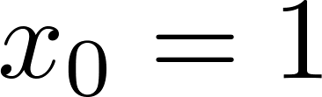
Multiple features (variables)
Hypothesis:
Previously:
Now:
For convenience of notation, define .

Slide 37
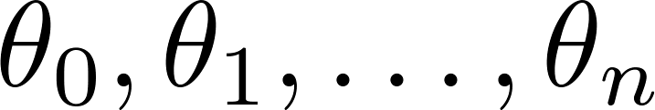
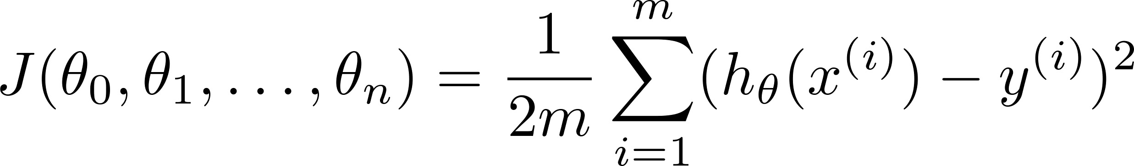

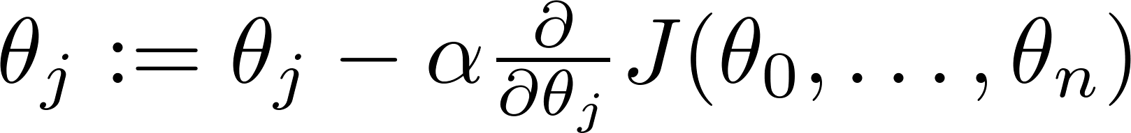

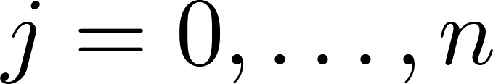
Gradient descent for multiple variables
Hypothesis:
Parameters:
Cost function:
Gradient descent:
Repeat
(simultaneously update for every )

Slide 38

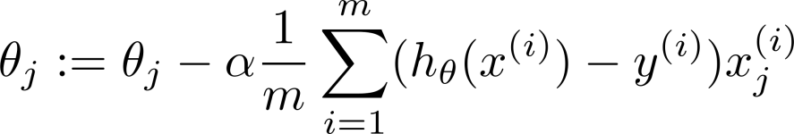









Gradient descent for multiple variables
New algorithm :
Gradient Descent
Repeat
Previously (n=1):
Repeat
(simultaneously update for
)
(simultaneously update )

Slide 39









Feature Scaling
Feature Scaling
Idea: Make sure features are on a similar scale.
E.g. = size (0-2000 feet²)
= number of bedrooms (1-5)
size (feet²)
number of bedrooms

Slide 40





Gradient descent for multiple variables
Mean normalization
Replace with to make features have approximately zero mean (Do not apply to ).
E.g.

Slide 41


Learning rate
Gradient descent
“Debugging”: How to make sure gradient descent is working correctly.
How to choose learning rate .

Slide 42


Learning rate
Making sure gradient descent is working correctly.
Example automatic convergence test:
Declare convergence if decreases by less than in one iteration.
No. of iterations

Slide 43




Learning rate
Gradient descent not working.
Use smaller .
No. of iterations
No. of iterations
No. of iterations
For sufficiently small , should decrease on every iteration.
But if is too small, gradient descent can be slow to converge.

Slide 44
Learning rate
Summary:
If is too small: slow convergence.
If is too large: may not decrease on every iteration; may not converge.
To choose , try

Slide 45
To be Continued……

